Slide 1
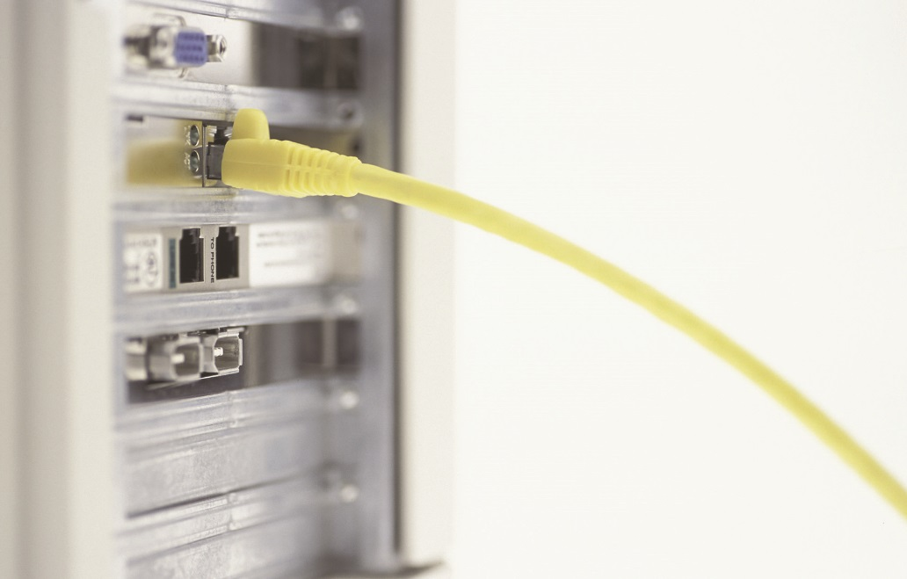
IT Essentials (CompTIA A+) Ch. 21
Local Area Networking
Chapter 21
Notes:
1

Slide 2
Overview
In this chapter, you will learn how to:
Explain the basics of TCP/IP
Install and configure wired networks
Troubleshoot wired networks
Notes:
2

Slide 3
TCP/IP
Network protocol software:
Takes incoming data received by the network card, keeps it organized, and sends it to the application that needs it
Takes outgoing data from the application and hands it to the NIC to be sent out over the network
The Transmission Control Protocol/Internet Protocol (TCP/IP) is the primary protocol of most modern networks, including the Internet.

Slide 4
Network Addressing with IPv4
Any network address must provide two pieces of information:
Uniquely identify the machine
Locate that machine within the larger network
In a TCP/IP network, the IP address identifies the PC and the network on which it resides.

Slide 5
Network Addressing with IPv4
The IP address
Unique identification for your system on the network
Relies on Internet Protocol version 4 (IPv4) addressing scheme
Four sets of eight binary numbers, separated by periods

Slide 6
Network Addressing with IPv4
Parts of an IP address include:
The network ID portion identifies the network.
The host ID, or host part identifies the local computer on the network.
Subnet mask distinguishes which part of the IP address identifies the network ID and which part of the address identifies the host.
Blocks out (or masks) the network portion of an IP address
Typical subnet mask: 255.255.255.0
Notes:
Make sure you understand the differences between subnet masking and CIDR notation principles.

Slide 7
Network Addressing with IPv4
Given the following as an example:
IP address: 192.168.4.33
Subnet mask: 255.255.255.0
Compare the subnet mask to the IP address:
Any part that’s all 255s is the network ID
Any part that’s all zeros is the host ID
The result:
Network ID is 192.168.4
Host ID is 33

Slide 8
Network Addressing with IPv4
Every computer on a single LAN must have the same network ID and a unique host ID.
Every computer on the network must have a unique IP address.
An IP conflict:
Two computers have the same IP address; they won’t be able to talk to each other; and other computers won’t know where to send data.
You can never have an IP address that ends with a 0 or a 255.

Slide 9
Network Addressing with IPv4
Classless Inter-Domain Routing (CIDR)
Network techs refer to the subnet mask by the number of 1s it contains.
From a practical standpoint, all you have to know as a tech is how to set up a computer to accept an IP address and subnet mask combination that your network administrator tells you to use.

Slide 10
Interconnecting Networks with Routers
Router – device with at least two IP addresses
Default gateway
The IP address of the “LAN” side of your router (the port connected to your LAN) – the address your computer uses to send data to anything outside your network ID

Slide 11
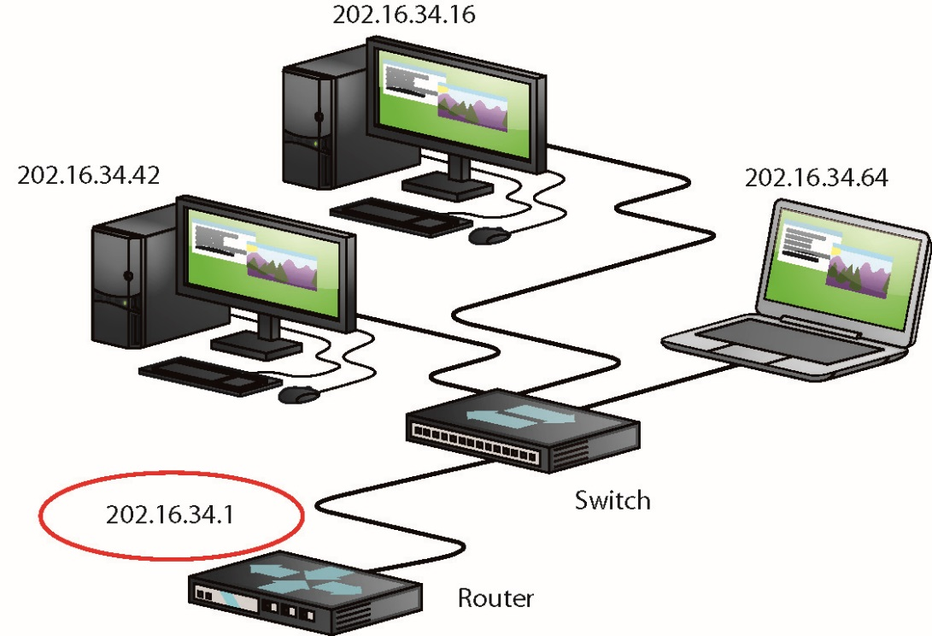
Interconnecting Networks with Routers
Figure 21.1 Default gateway

Slide 12
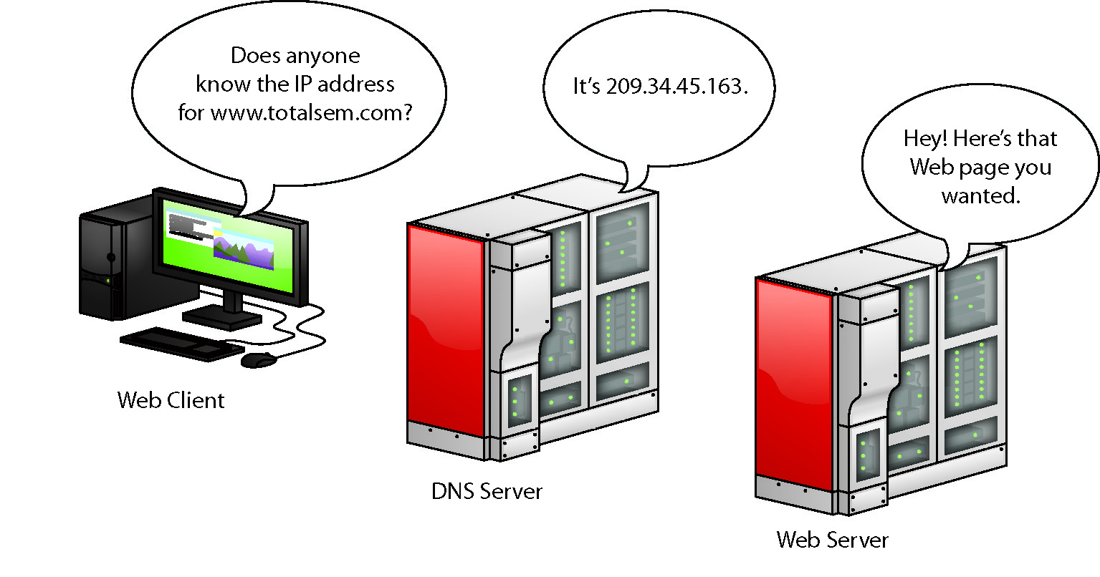
Interconnecting Networks with Routers
Domain Name Service (DNS)
Special computers, called Domain Name Service (DNS) servers, keep databases of IP addresses and their corresponding names.
The Internet has regulated domain names.
Figure 21.2 Domain name service

Slide 13
Interconnecting Networks with Routers
Entering the IP information
When you’re configuring a computer to connect to a network, you must enter:
The IP address
The subnet mask
The default gateway
At least one DNS server

Slide 14
Interconnecting Networks with Routers
If you have Dynamic Host Control Protocol (DHCP) and your computer is configured to obtain an IP address automatically, your computer boots up and will broadcast a DHCP request.
The DHCP server provides your computer with all the IP information it needs to get on the network.
You can also manually input an IP address creating a static IP address.

Slide 15
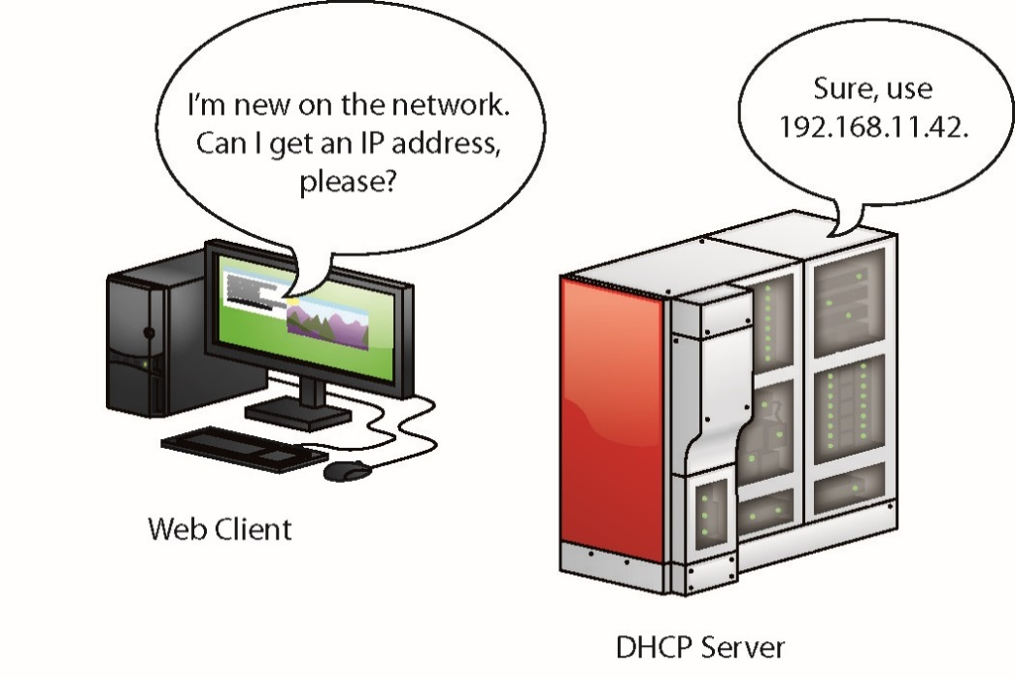
Interconnecting Networks with Routers
Figure 21.4 A DHCP server handing out an IP address

Slide 16
TCP/UDP
When moving data from one system to another, the TCP/IP protocol suite needs to know if the communication is connection-oriented or connectionless.
The connection-oriented protocol used with TCP/IP is called the Transmission Control Protocol (TCP).
The connectionless one is called the User Datagram Protocol (UDP).
Most TCP/IP applications use TCP instead of UDP.

Slide 17
TCP/UDP
TCP gets an application’s data from one machine to another reliably and completely.
Communication rules require both the sending and receiving machines to acknowledge the other’s presence and readiness to send and receive data.
UDP does not ensure that the data is received intact.
Works best when you have a lot of data to send that doesn’t need to be perfect

Slide 18
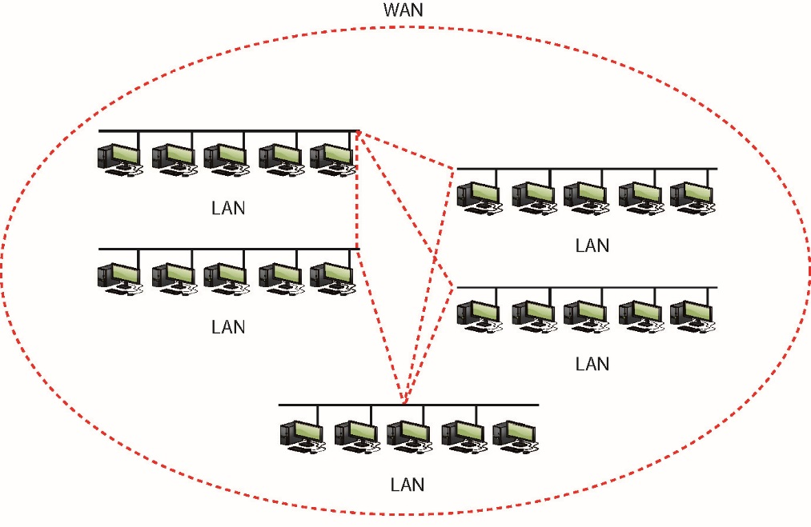
TCP/IP Services
TCP/IP services link any two hosts whether the two computers are on the same LAN or on some other network within the WAN.
Hypertext Transfer Protocol (HTTP) is the language of the World Wide Web.
Figure 21.5 WAN concept

Slide 19
TCP/IP Settings
Proper settings are needed to ensure proper network functionality.
In Windows, you can configure network settings from the appropriate networking applet.
Right-click on Network and select Properties.
Alternatively, open the Control Panel and select Network and Sharing Center.

Slide 20
TCP/IP Tools
All modern operating systems come with handy tools to test and configure TCP/IP.
Open a command prompt to run them.
The ping command is a great way to see if another system is connected to the network.
Use the command-line tool ipconfig for a quick glance at your network settings.
From a command prompt, type ipconfig /all to see all of your TCP/IP settings.
The ifconfig command in Mac OS X and Linux provides the same level of detail with no switches applied.

Slide 21
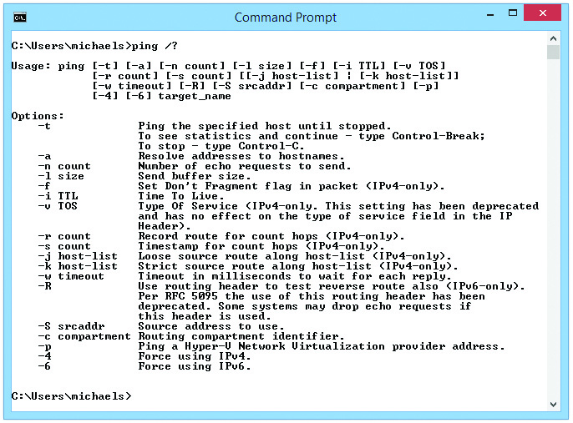
TCP/IP Tools
Figure 21.7 The ping command’s syntax

Slide 22
TCP/IP Tools
The nslookup command enables you to determine exactly what information the DNS server is giving you about a specific host name.
Type nslookup from the command prompt and press the ENTER key.

Slide 23
TCP/IP Tools
The tracert utility (traceroute in Mac) shows the route that a packet takes to get to its destination.
From a command line, type tracert followed by a space and an IP address or URL.
The output describes the route from your machine to the destination machine.
Includes all devices the packet passes through and how long each hop between devices takes

Slide 24
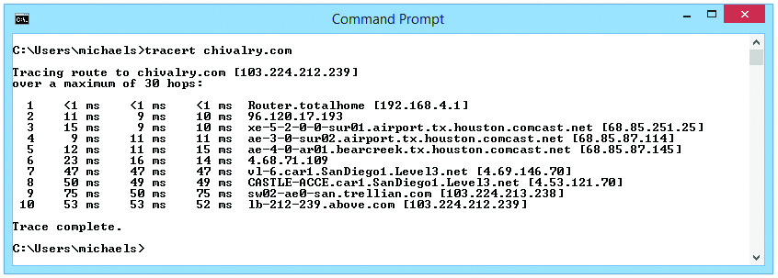
TCP/IP Tools
Figure 21.10 The tracert command in action

Slide 25
Configuring TCP/IP
By default, TCP/IP is configured to receive an IP address automatically from a DHCP server on the network (and automatically assign a corresponding subnet mask).
CompTIA A+ expects you to know how to do this manually.

Slide 26
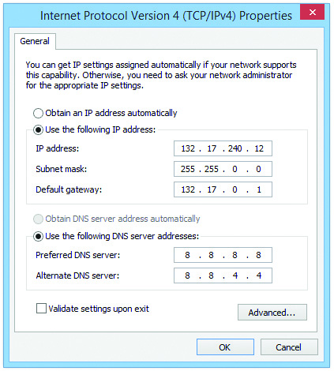
Configuring TCP/IP
Figure 21.11 Setting up IP

Slide 27
Automatic Private IP Addressing
Modern operating systems support a feature called Automatic Private IP Addressing (APIPA) that automatically assigns an IP address to the system when the client cannot obtain an IP address automatically.
The Internet Assigned Numbers Authority has set aside the range of addresses from 169.254.0.1 to 169.254.255.254 for this purpose.

Slide 28
Network Addressing with IPv6
The 32-bit IPv4 standard offers only 4 billion addresses.
More addresses needed with the global Internet
The Internet Engineering Task Force (IETF) Internet Protocol version 6 (IPv6).
Addressing scheme that is slowly replacing IPv4
Extends the 32-bit IP address space to 128 bits, allowing up to 2¹²⁸ (or 3.4 × 10³⁸) addresses

Slide 29
IPv6 Address Notation
IPv6 addresses are written like this: 2001:0000:0000:3210:0800:200C:00CF:1234
Colon is a separator between groups.
Each group is a hexadecimal number between 0000 and FFFF called (unofficially) a field or hextet.
A complete IPv6 address always has eight groups.
IPv6 still uses subnets.
IPv6 uses the “/x” Classless Inter-Domain Routing (CIDR) nomenclature.
The /x refers to the number of bits in the subnet mask.
Notes:
The unspecified address (all zeros) can never be used, and neither can an address that contains all ones (in binary) or all Fs (in hex notation)

Slide 30
Where Do IPv6 Addresses Come From?
Instead of one IP address, you can have three IP addresses on a single network card.
When a computer running IPv6 first boots up, it gives itself a link-local address.
This is equivalent to IPv4’s APIPA address.
Last 64 bits of IPv6 address depend on the OS.
Windows makes a random value that is unique and never changes.
Linux and Mac OS X build the value from the MAC address of the network card (called the Extended Unique Identifier, 64-bit, or EUI-64).

Slide 31
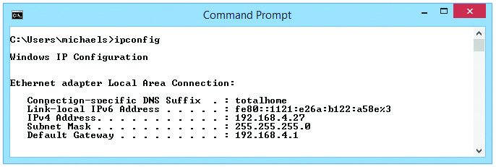
Where Do IPv6 Addresses Come From?
Figure 21.12 Link-local address in ipconfig
Notes:
Every computer running !Pv6 will always have at least a link-local address.

Slide 32
IPv6 Subnet Masks
IPv6 subnets function like IPv4 subnets.
Two new rules apply:
The last 64 bits of an IPv6 address are generated randomly or using the MAC address, leaving a maximum of 64 bits for the network ID.
Therefore, no subnet is ever longer than /64.
The IANA passes out /32 subnets to big ISPs.
ISPs and others may pass out /48 and /64 subnets to end users.
The vast majority of IPv6 subnets are between /48 and /64.

Slide 33
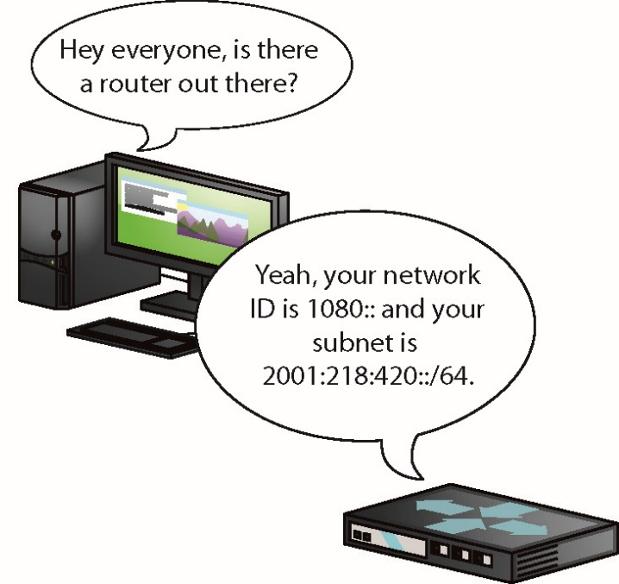
Global Addresses
To get on the Internet, a system needs a second IPv6 address called a global address.
The most common way to get a global address is to request it from the default gateway router.
The gateway router must be configured to allow for this.
Figure 21.13 Getting a global address

Slide 34
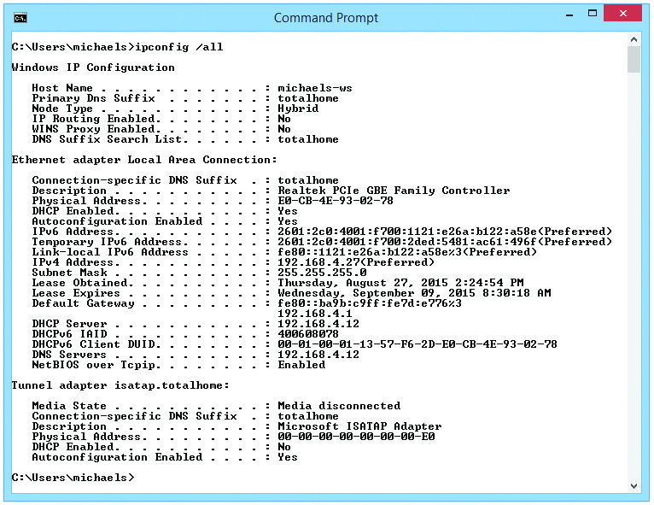
Global Addresses
Figure 21.15 The ipconfig command with IPv6 and IPv4

Slide 35
Installing and Configuring a Wired Network
Three things need to be in place to have network connectivity:
Connected NIC
The physical hardware that connects the computer system to the network media
Properly configured TCP/IP
Correct TCP/IP settings needed for device on your network
Network client
The interface that allows the computer system to speak to the protocol

Slide 36
Installing a NIC
The NIC is your computer system’s link to the network.
NICs are manufactured to operate on specific media and network types, such as 1000BaseT Ethernet.
Follow the manufacturer’s instructions for installation.

Slide 37
Full-Duplex
All modern NICs can run in full-duplex mode, meaning that they can send and receive data at the same time.
The vast majority of NICs and switches use a feature called auto-sensing to accommodate very old devices that might attach to the network and need to run in half-duplex mode.

Slide 38
Half-Duplex
Half-duplex means that the device can send and receive, but not at the same time.
Half-duplex devices are exceedingly rare in modern computers, but you need to understand this option.

Slide 39
Link Lights
NICs made today have some type of link light—a light-emitting diode (LED) status indicator that provides information about the state of the NIC’s link.
NICs can have between one and four different link lights.
LEDs can be any color.
Link lights are one of the first items to check whenever you think a system is disconnected from the network.

Slide 40
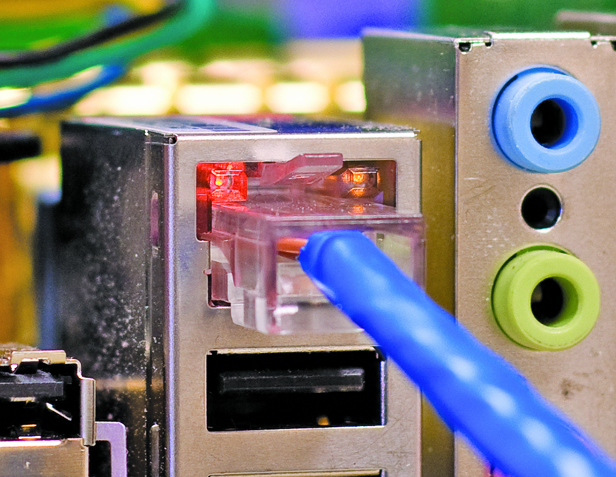
Link Lights
Figure 21.16 Mmmm, pretty lights!

Slide 41
Link Lights
The activity light turns on when the card detects network traffic.
Intermittently flickers when operating properly
There are no standards governing how NIC manufacturers use their lights.

Slide 42
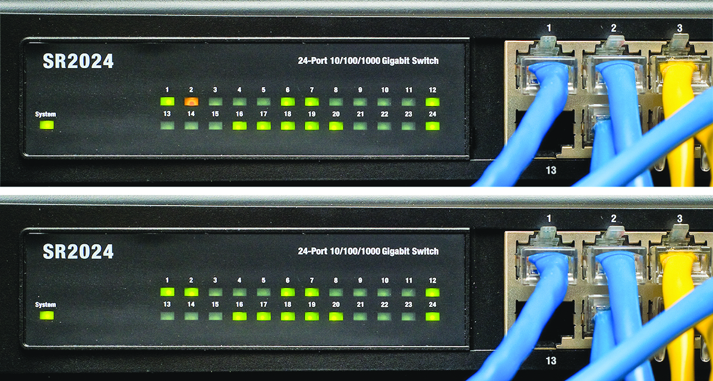
Link Lights
Figure 21.17 Multispeed lights

Slide 43
Wake-on-LAN
A popular feature of most NICs is the ability to turn on or wake up a powered-down or sleeping PC.
To wake up one or multiple computers that you aren’t physically near, use a second PC to send either:
A special pattern
Or a magic packet (a broadcast packet that essentially repeats the destination MAC address many times)

Slide 44
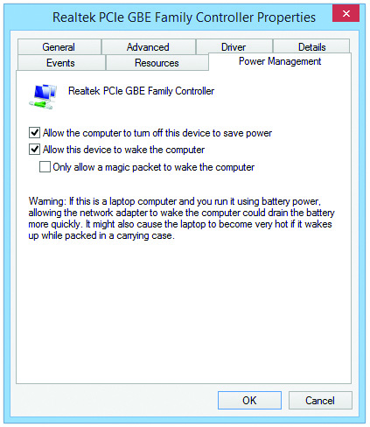
Wake-on-LAN
Figure 21.18 Wake-on-LAN settings on the Power Management tab

Slide 45
QoS
Quality of service (QoS) enables busy networks to prioritize traffic.
Support for QoS tagging (or priority) should be enabled by default on most network adapters.

Slide 46
Configuring a Network Client
To establish network connectivity, you need a network client installed and configured properly.
Installed as part of the OS installation, the Client for Microsoft Networks rarely needs configuration.
Few configuration options are available.

Slide 47
Sharing and Security
Windows systems can share all kinds of resources, including:
Files, folders, drives, printers, faxes, and Internet connections

Slide 48
Network Shares
When you share over a network, every OS uses specific network sharing permissions to allow or restrict access to shared resources.
On a non-NTFS volume like an optical media disc or a flash-media USB drive, you only have three levels of permission:
Read, Read/Write, and Owner
A shared folder on an NTFS drive must have both the network permissions and the NTFS permissions set to let others access shared resources.
Notes:
You need to understand the difference between share permissions and NTFS permissions. Share permissions only apply to network sharing. NTFS permissions affect both network and local access to shared resources.

Slide 49
Network Organization
Windows and other operating system networks work in one of three categories:
Workgroups
Domains
Homegroups
These three organizations differ in:
Control
Number of machines needed
Compatibility
Security

Slide 50
Network Organization
Workgroups are the most basic and simplest network organization.
Non-centralized control over the network
All systems connected to the network are equals.
User names and passwords are stored in an encrypted format on your computer.
Sharing a folder
Right-click on the folder and select Share with | Specific people; this opens the File Sharing dialog box.
By default, you’ll see every user account that’s currently on this system.

Slide 51
Network Organization
You may give an account Read or Read/Write permission, while the person who created the folder is assigned as Owner.
Read – see what’s in the folder.
Read/Write – same as Read but you can save to folder.
Owner – same as Read/Write plus you can set permissions for other users on the folder.
To have access to a folder on another computer, a user must have a valid username and password.

Slide 52
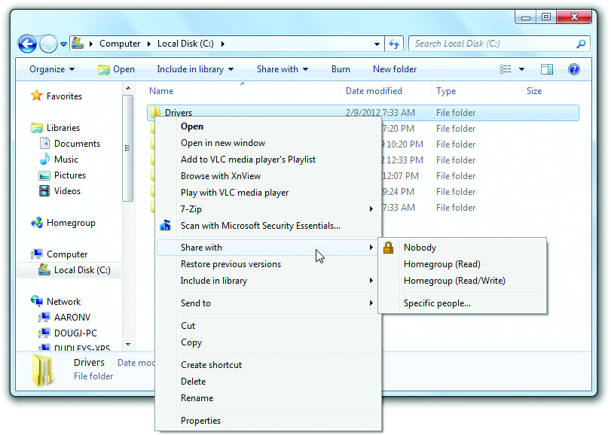
Network Organization
Figure 21.23 Folder Sharing with context menu

Slide 53
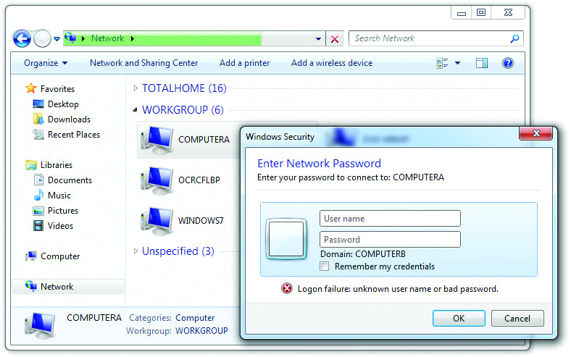
Network Organization
Figure 21.25 Prompt for entering user name and password

Slide 54
Domains
Larger networks that need more control use domains.
Domains require a specific server to control access to the network’s resources.
On a network of Windows machines, you must have a computer running a version of Windows Server.
An administrator creates a domain on the Windows Server system, which makes that system the domain controller (DC).
Domain accounts are created on this system.

Slide 55
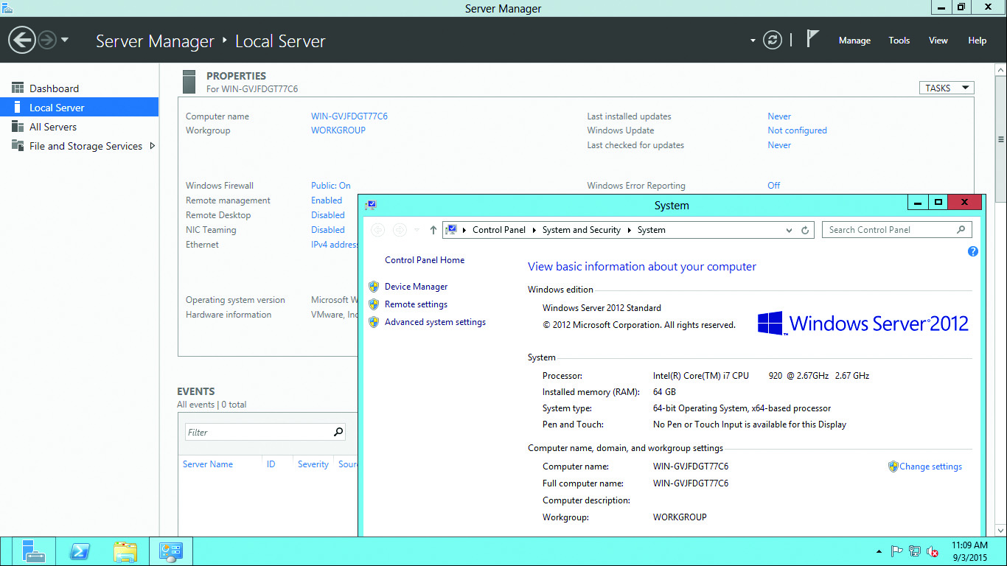
Domains
Figure 21.26 Windows Server

Slide 56
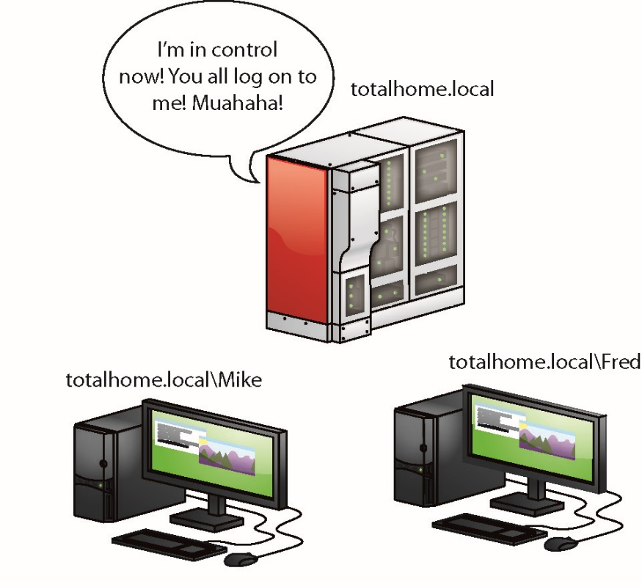
Domains
When using a domain, you don’t log on to your computer.
Instead, you log on directly to the domain.
You can log on to any computer on the domain using the same domain account.
Figure 21.28 Domain network

Slide 57
Homegroups
HomeGroup uses the idea that people want to share data, not folders.
Homegroups skip folders completely and share your Windows libraries.
Homegroups are available in Windows 7 and later.
To make a homegroup, open the HomeGroup Control Panel applet.
Notes:
Interestingly, all homegroup data is encrypted between systems.

Slide 58
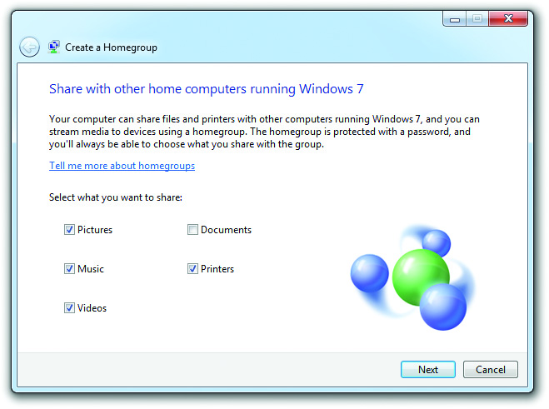
Homegroups
Figure 21.30 Create a Homegroup dialog box

Slide 59
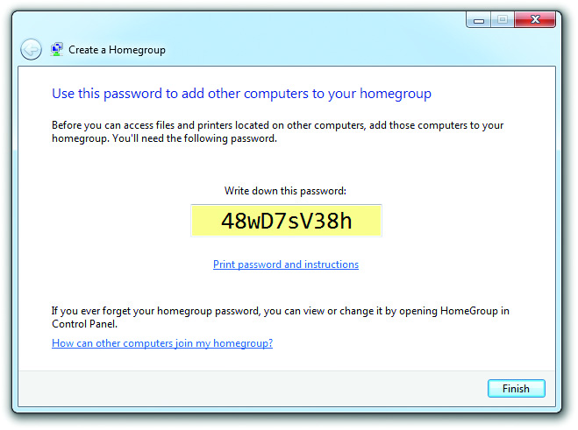
Homegroups
Figure 21.31 The homegroup’s password

Slide 60
Homegroups
Access the files shared through a homegroup by opening Windows Explorer or File Explorer.
There are four sharing options:
Nobody – means the item is not shared
Homegroup (Read)
Homegroup (Read/Write)
Specific people

Slide 61
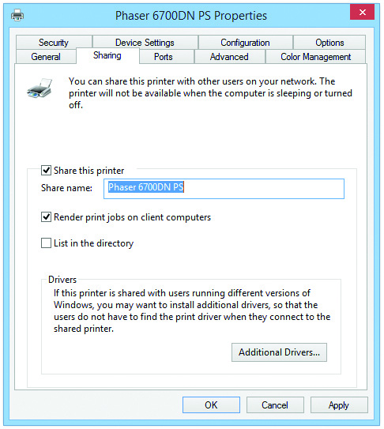
Sharing Printers
Follows the same process as sharing drives and folders.
Use Printers folder (Vista) or open Devices (Windows 7 and later)
Figure 21.36 Giving a name to a shared printer on Windows 8.1

Slide 62
Troubleshooting Networks
CompTIA A+ exams focuses on the skills to get a single computer back on the network.
There are two ways to look at connectivity issues:
Computer loses physical connectivity.
System is on the network but unable to access a particular resource.

Slide 63
Repairing Physical Cabling
Symptoms—total loss of connectivity
Red X over network icon indicates loss of connectivity.
First check the obvious:
Is the cable unplugged at your system? At the wall outlet?
Then check the less obvious:
Is the NIC disabled in Device Manager? Is the cable connected to the switch?

Slide 64
Repairing Physical Cabling
Diagnosing physical problems
Intermittent loss is harder to trace.
Look for errors that point to physical disconnection.
A “No server is found” error
No systems seen other than own in the system’s network explorer utility
Multiple systems failing to access the network

Slide 65
Repairing Physical Cabling
Check the Lights
Check the link lights on the NIC and switch.
If they’re not lit, the cable isn’t connected somewhere.
Check to see if other people have network access.
Inspect the cable running from the back of the PC to the outlet.
Finally, plug the system into a known good outlet and see if it works.
If connectivity works with the second outlet, suspect the structured cable that is running from the first outlet to the switch.

Slide 66
Repairing Physical Cabling
Check the NIC
A bad NIC can also generate a “can’t see the network” problem.
Use the utility provided by the OS to verify that the NIC works.
If you’ve got a NIC with diagnostic software, run it—this software will check the NIC’s circuitry.
The NIC’s female connector is a common failure point.
NICs that come with diagnostic software often include a special test called a loopback test.

Slide 67
Repairing Physical Cabling
A loopback test sends data out of the NIC and checks to see if it comes back.
Some NICs perform only an internal loopback.
Tests the circuitry that sends and receives, but not the actual connecting pins.
A true external loopback requires a loopback plug inserted into the NIC’s port.
If the NIC is bad, replace it.

Slide 68
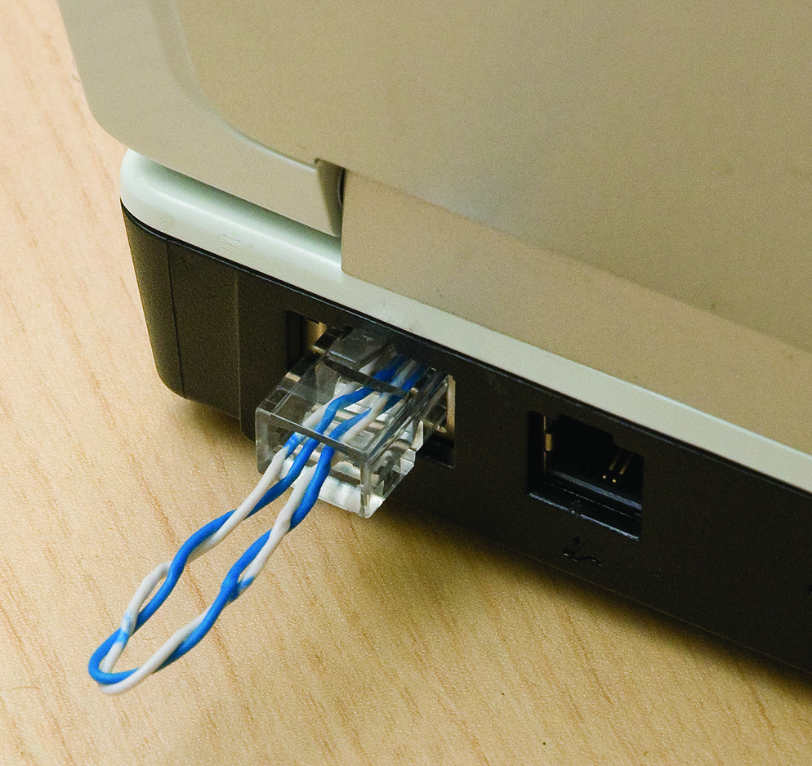
Repairing Physical Cabling
Figure 21.38 Loopback plug

Slide 69
Repairing Physical Cabling
Cable testing
With the right equipment, diagnosing a bad horizontal cabling run is easy.
A tech should own a midrange time-domain reflectometer (TDR) tester such as the Fluke MicroScanner.
A TDR measures impedance in network cabling. If the tester measures any impedance, something is wrong with the cable.
When you’re testing a cable run, always include the patch cables as you test.

Slide 70
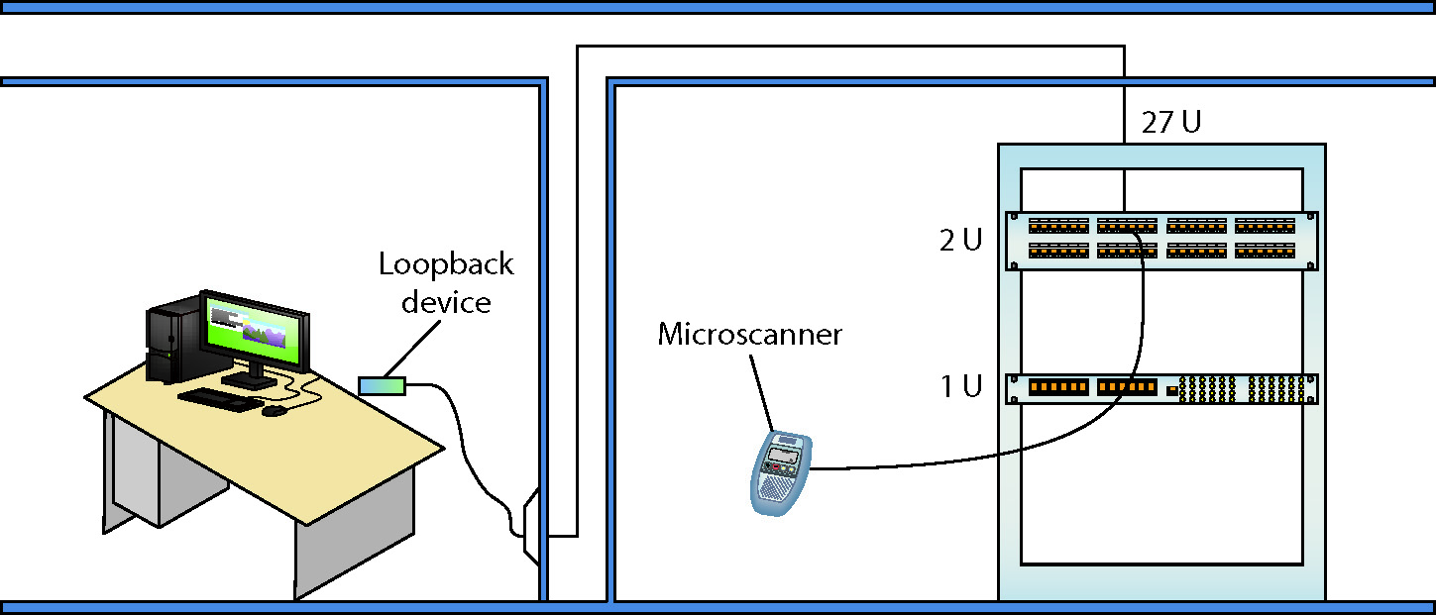
Repairing Physical Cabling
Figure 21.39 Cable tester in action

Slide 71
Repairing Physical Cabling
Toners
Toner is the generic term for two separate devices that are used together: a tone generator and a tone probe.
The tone generator connects to the cable using alligator clips, tiny hooks, or a network jack.
It sends an electrical signal along the wire at a certain frequency.
The tone probe emits a sound when it is placed near a cable connected to the tone generator.

Slide 72
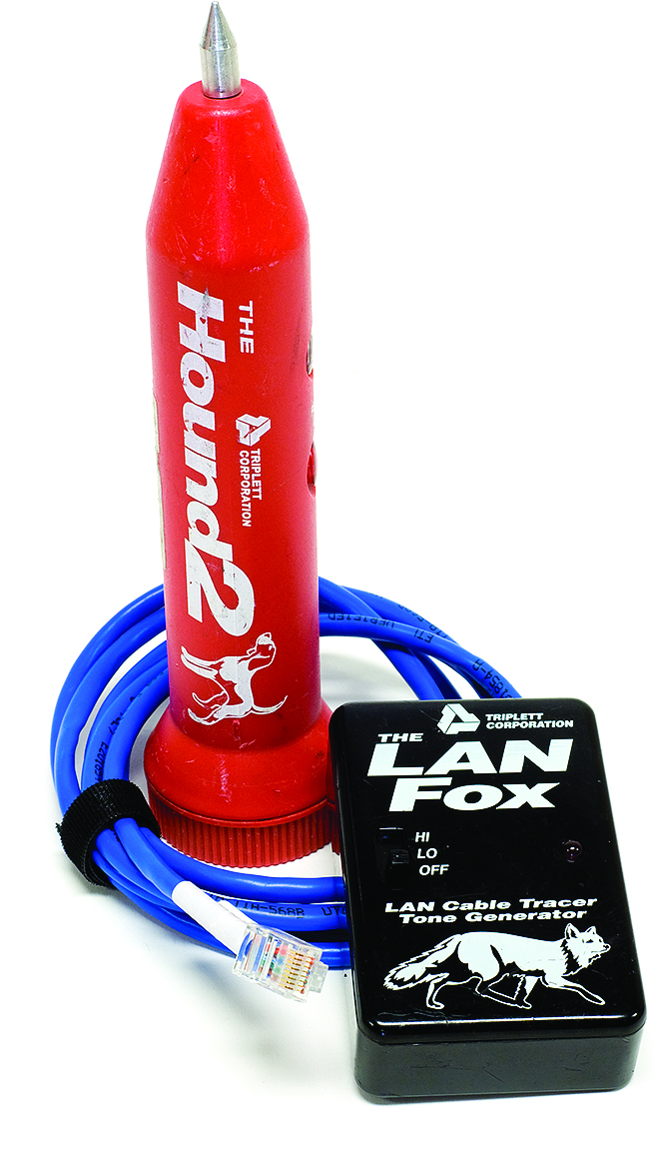
Repairing Physical Cabling
Figure 21.40 Fox and Hound

Slide 73
Fixing Common Problems
Failure to connect a new resource usually points to a configuration issue.
Do you have the right share name?
Go check at the serving system.
Do you have the required user name/password?
Ask someone who might have this knowledge, or double-check that your account has access.
Do you have permission to use/access/connect to the shared resource?
Make sure you have the correct permissions.

Slide 74
Fixing Common Problems
Failure to connect a new resource
Are you on the right homegroup/domain/workgroup?
Check your system and the sharing system to verify which workgroup/domain name to use.
On a homegroup, make sure you’ve used the proper password.
Is the folder or printer shared?
Share it!
Does the folder or printer exist?
Ensure serving system still hosts the folder.
Install the network printer if you haven’t yet.

Slide 75
Fixing Common Problems
Failure to connect a previously used resource
Check that you can see the resource using Network.
Check that the serving system is on.
Check that the computer is physically connected to the serving system.

Slide 76
The net Command
Windows enables you to view a network quickly from the command line through the net command.
Type net at a command prompt and press ENTER.
When run, net view returns a list of Windows computers on the network.

Slide 77
The nbtstat Command
The nbtstat command is an old command-line utility that predates Windows.
Stands for NetBIOS over TCP/IP Statistics.
Provides insight when troubleshooting naming issues in small workgroups

Slide 78
Questions?

Slide 79
Summary
Explain the basics of TCP/IP
Install and configure wired networks
Troubleshoot wired networks

Slide 80


